Slide 1

Road Accident Traffic Prediction
IST 718
Eric Greenstein, Shubham Kumar, Eamon Gallagher

Slide 2
Problem Statement
Even minor accidents can have an effect on traffic patterns. The goal of this project is to predict how long an accident will affect traffic based on the information available when it occurs.
Knowing when an accident will clear is integral to many kinds of services. Web mapping services like Apple’s “Maps,” for example, rely on this information for quality routing.

Slide 3
Data Set: “US Accidents (Updated)”
From kaggle.com
Includes data from 1.5 million US motor vehicle accidents from 2016-2020. data was collected from traffic APIs that compile a variety of information from a multitude of sources.
Data can be found here!

Slide 4
Data Set Cont.
Rows: 1,516,064
Columns: 47
Main Features:
Severity of Accident
Start & End Time of Traffic
Length of Road Affected
Locations: Lat, Long, Address, nearby points of interest (13 Booleans: stop, crossing railway, etc).
Weather: Temp, Humidity, Visibility, Wind Statistics, Precipitation, Condition.

Slide 5
Data Set Cont.
Cleanliness
Duplicates with separate ID’s
Traffic Time Errors (see next slide)
Some NAs and outliers for numerical columns
Prediction Variable:
Length_Minutes: How long until traffic cleared?
Determined by subtracting Start_Time from End_Time

Slide 6
Statistical Analysis

Slide 7
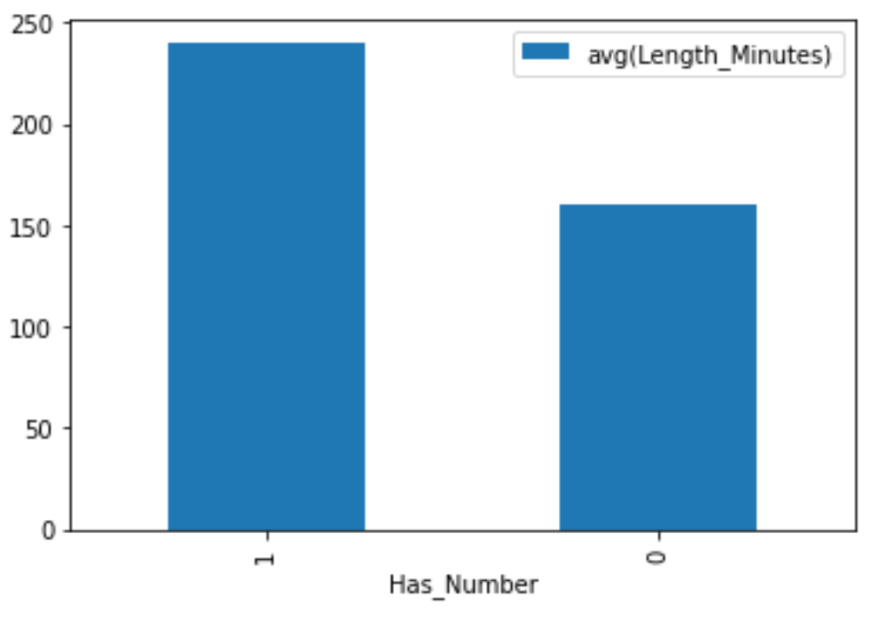
Accidents reported with an address number take longer to clear on average

Slide 8
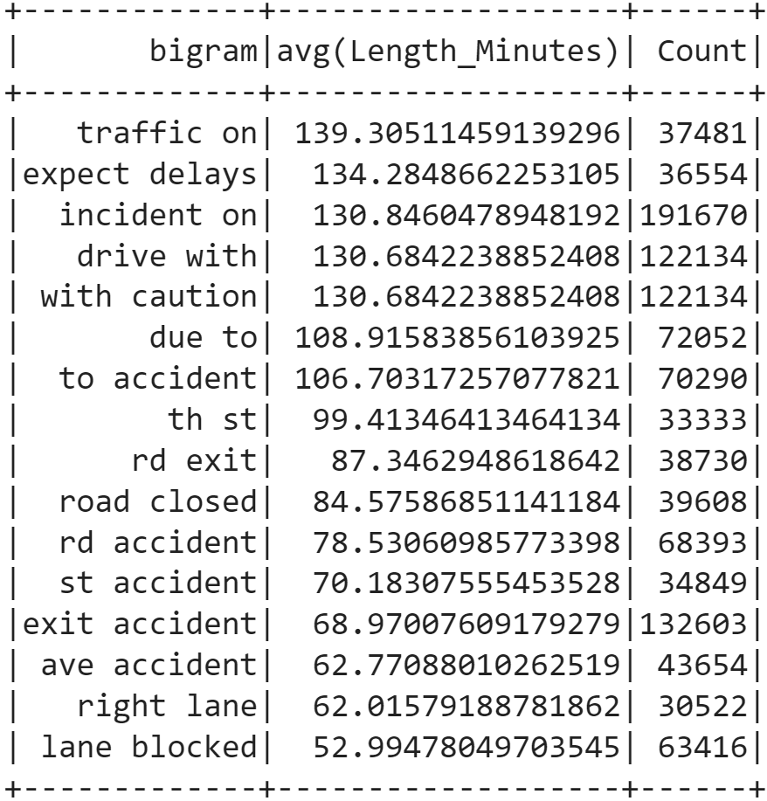
Description Bigram Analysis

Slide 9
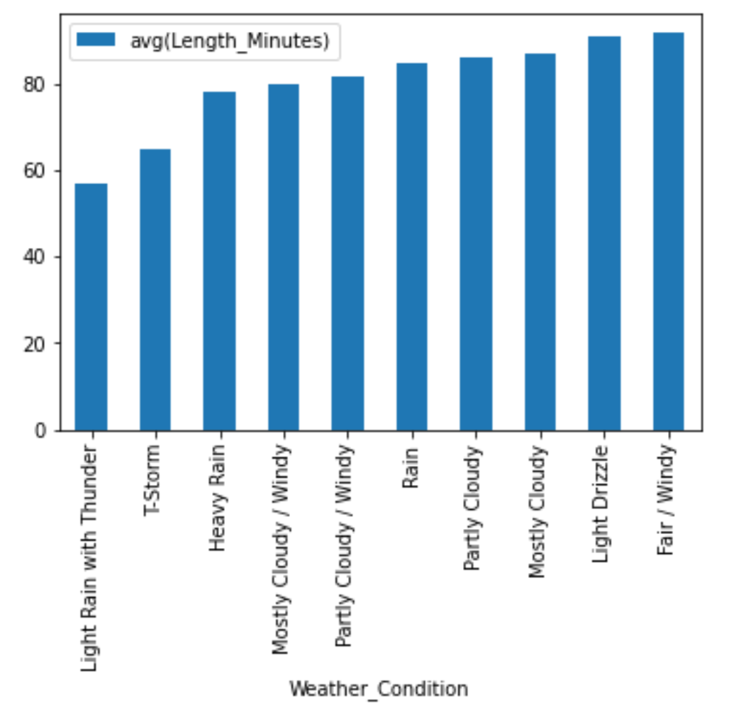
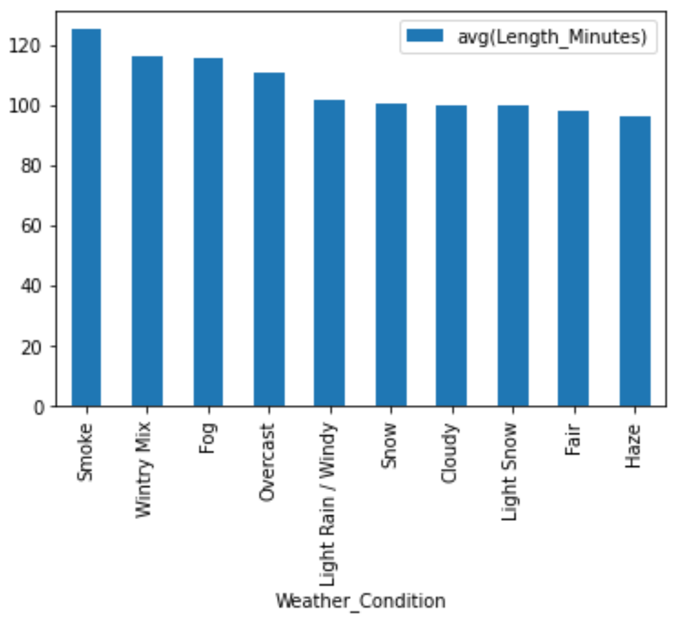
Length_Minutes vs Weather_Condition (minimum 1000 observations)
Conditions with lowest avg(Length_Minutes)
Conditions with highest avg(Length_Minutes)

Slide 10
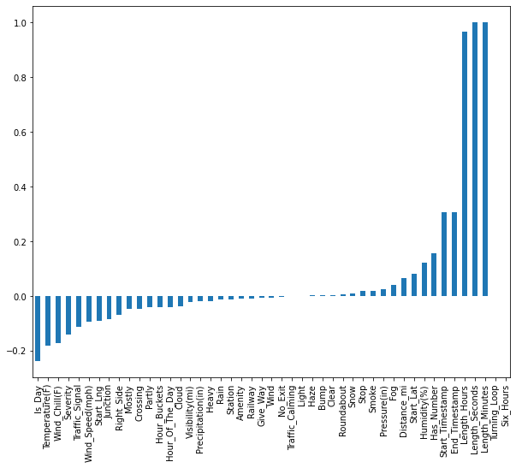
Correlation with the dependent column

Slide 11
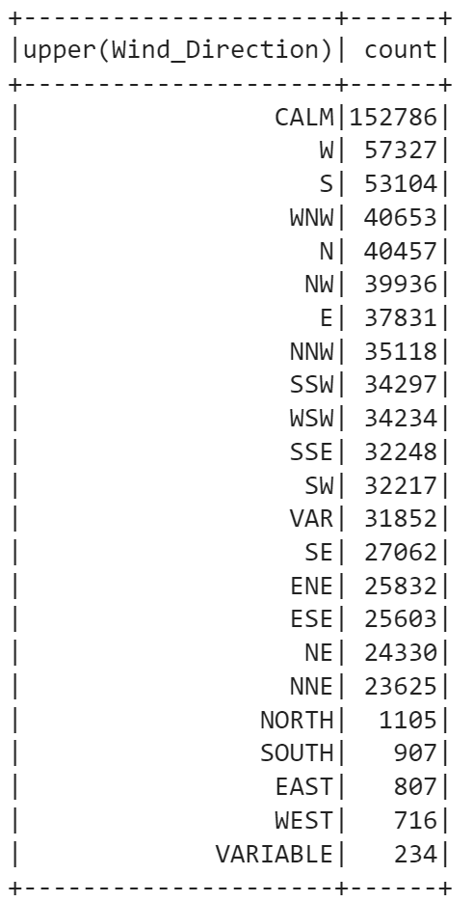
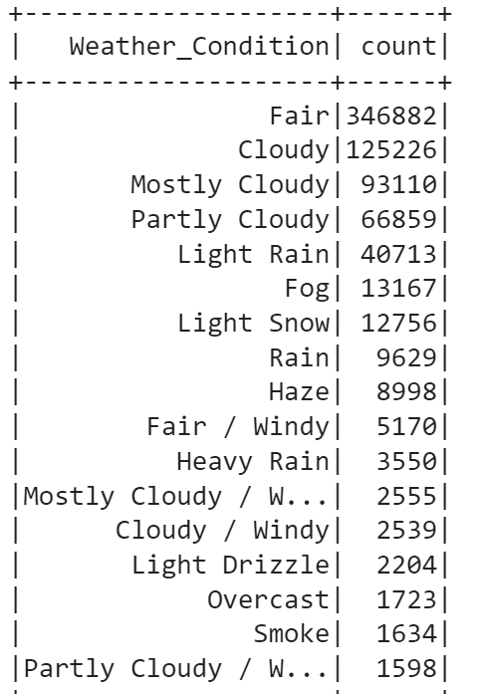
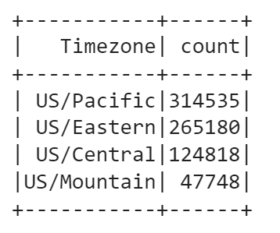
String Features Passed through the String Indexer

Slide 12
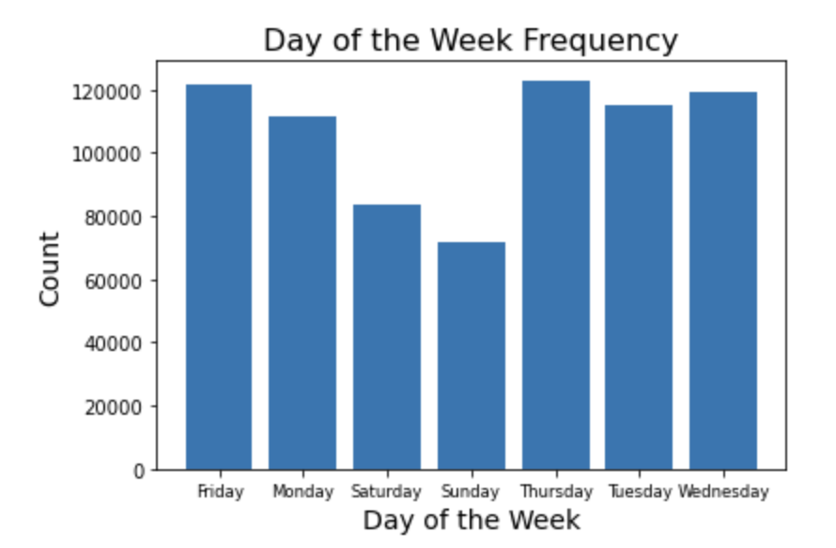
Day of the week Frequencies

Slide 13
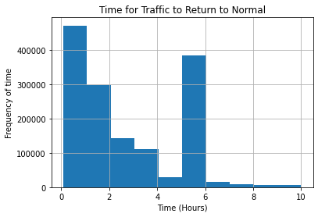
Traffic Time Lengths
Something isn’t right here...

Slide 14
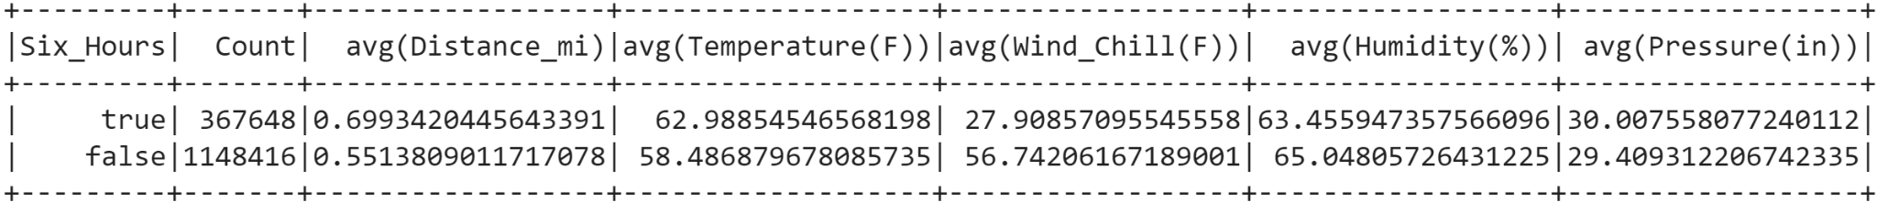
About ⅓ of the accidents lasted exactly 6 hours!
Also the avg(Wind_Chill) is 30 degrees lower than the avg(Temp) for these observations?
We can conclude that these observations are incomplete; they likely derived from a different source.

Slide 15
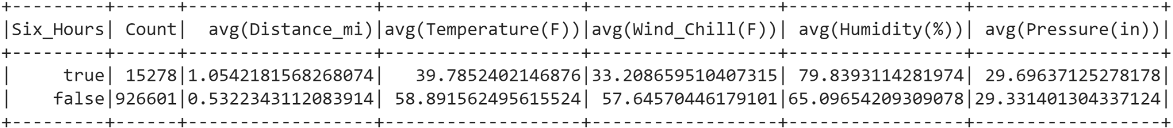
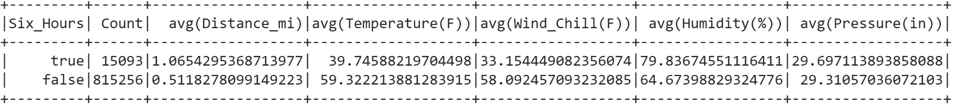
Cleaning
Over half of the Six_Hours observations included NAs in relevant columns, compared to about 20% for the rest of the observations.
Once duplicates are removed, we are left with 815,256 valid observations. Still plenty of data to work with.

Slide 16
Outliers
Outliers can skew a model, making it less effective at prediction of standard observations. Outliers were identified as observations below Q1-IQR or above Q3+IQR.
Removed observations include those with:
Time to clear greater than 5 hours
Pressure(in) greater than 50

Slide 17
Feature Engineering

Slide 18
Feature Engineering: Time
Time of Day: Observations placed in 12 categorical bins based on when the accident occured. These bins will be used in the StringIndexer
00:00-02:00, 2:00-4:00, etc.
Day of Week: Observations were also placed in bins based on the day of week the accident occured.

Slide 19
Feature Engineering: Location
The categorical “Timezone” variable was converted into dummy variables, with a StringIndexer.
The booleans referring to nearby points of interest can also be used as predictors. The majority of observations don’t have a point of interest, meaning no baseline is needed.
Whether the accident is reported with a street number is also a key variable.

Slide 20
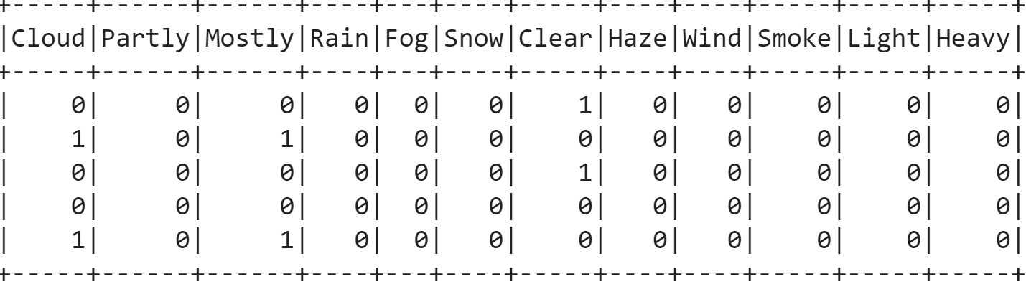
Feature Engineering Weather
7 numerical weather variables were scaled and used as predictive features: Temperature(F), WindChill(F), Humidity(%), etc.
In addition, one-hot encoded columns were added as to whether the Weather_Condition contained certain keywords. The bulk of the observations, including about half of them with Weather_Condition “Fair” were used as a baseline. The result is a matrix with the following structure:

Slide 21
Model Building

Slide 22
The Question:
What factors affect an accident time to clear?
Can we effectively predict how long in minutes an accident will affect traffic flow?

Slide 23
Models and techniques
Due to the continuous nature of the problem, we have chosen to develop regression models.
Linear and random forest regression models will be evaluated.

Slide 24
Model Pipeline
VectorAssembler
Standard Scaler
Clean Data
More Encoded Features
Regression
Fit & Transform
String Indexer
VectorAssembler
OneHotEncoder
VectorAssembler

Slide 25
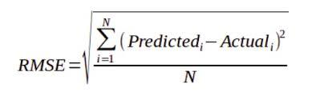
Model Evaluation
Evaluation Metric: RMSE
60:30:10 split for Training:Validation:Testing

Slide 26
Model Comparison

Slide 27
Model | RMSE
Linear Regression + No Outlier removal + Top weather features | 2674 mins
Linear Regression + Removing Data more than 5 hours + All weather features | 68.27 mins
Linear Regression + Reduced categorical + All weather features | 66.38 mins
Linear Regression + Reduced categorical + All weather features + Hour Buckets | 66.37 mins
Linear Regression(L1/L2 penalty ) + Reduced categorical + All weather features + Hour Buckets | 66.38 mins
RandomForestRegressor + Reduced categorical + All weather features + Hour Buckets | 59.5 mins

Slide 28
New Pipeline including PCA
VectorAssembler
Standard Scaler
Clean Data
More Encoded Features
Regression
Fit & Transform
String Indexer
VectorAssembler
OHE
PCA
VectorAssembler

Slide 29
Model Evaluation
Model | RMSE
RandomForestRegressor + Reduced categorical + All weather features + Hour Buckets + latitude + longitude + PCA | 54.2 mins
DecisionTreeRegressor + Reduced categorical + All weather features + Hour Buckets + latitude + longitude + PCA | 58.62 mins

Slide 30
Lessons Learned and Future Scope
Clustering of observations using the “Description” text column failed, likely due to the size of the matrix. Key features could be derived from this model (bigrams, trigrams) and used to improve the model.
Use cross validation instead of plain Validation testing
Explore Data extrapolation for the 6 hour “bad-data”
Derive other features from columns given in the dataset, search for additional data sources.

Slide 31
Thank you!

